Slide 1
Fascism: Mussolini and Hitler

Slide 2
Fascism
A political movement
Emphasized loyalty to the state and obedience to the leader
Promised to revive the economy, punish those responsible for hard times and restore the national pride
Does not have a clear program (like communism)

Slide 3
Fascist Ideas

Slide 4
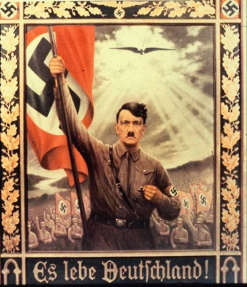
Extreme Nationalism

Slide 5
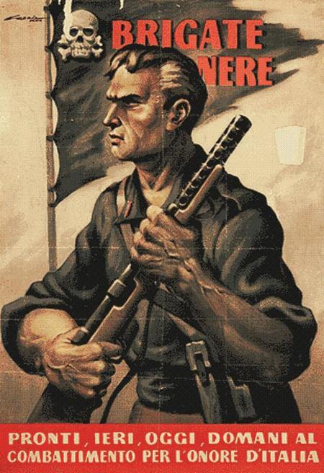
Nations Must Struggle

Slide 6
Loyalty to One Ruler
Calling people to support Hitler in building a new world by purchasing German-made products

Slide 7
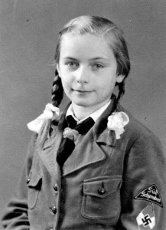
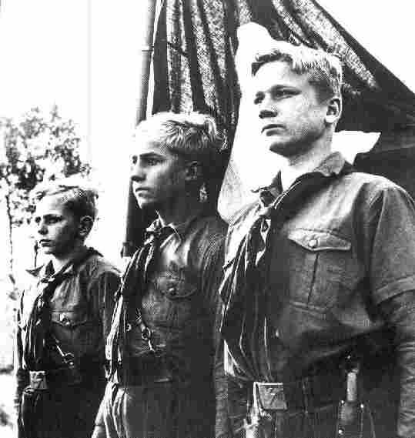
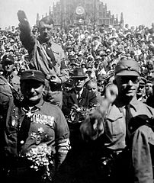
Uniforms

Slide 8
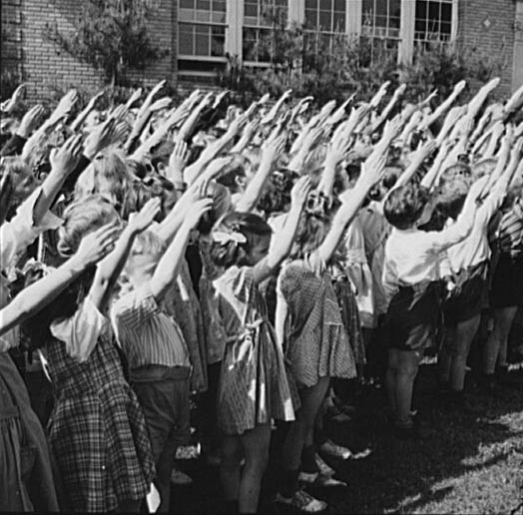
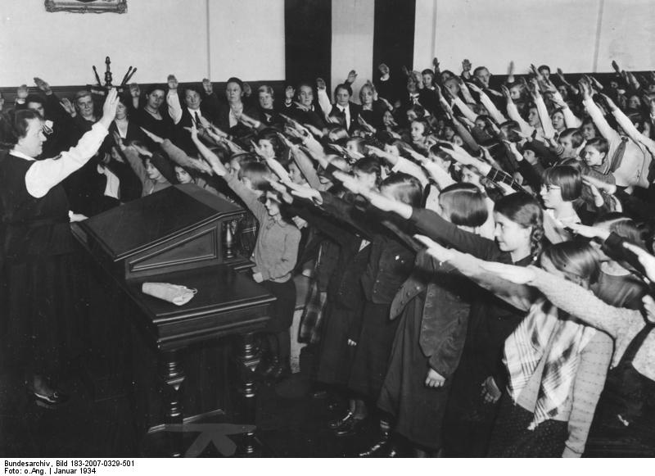
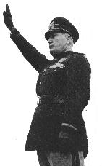
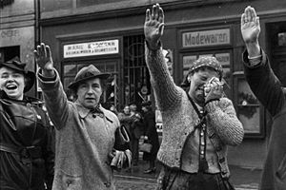
Salutes

Slide 9
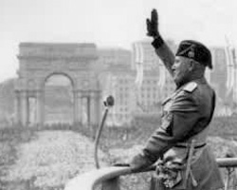
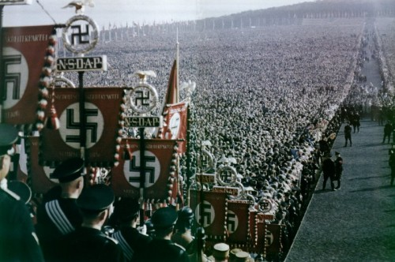
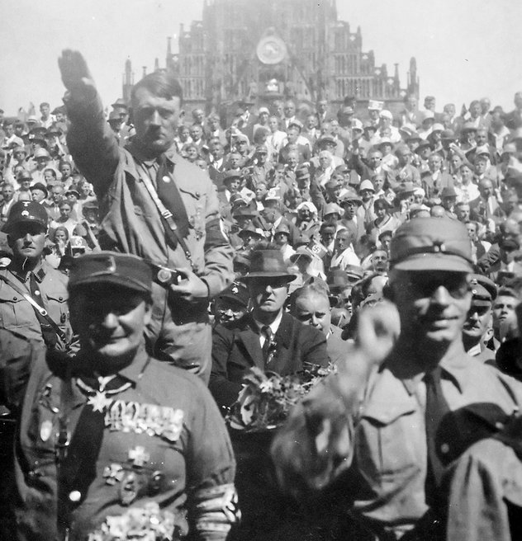
Mass Rallies

Slide 10
How is Fascism like Communism?
One Party Rule
No Democracy
No Individual Rights
Supremacy of the State
Use of Propaganda

Slide 11
How is Fascism different from Communism?
Communists wanted a classless society
Communism was international—wanted to unite all countries
Communists hated fascists
Fascists felt classes were important and served a purpose
Fascists were extremely nationalistic
Fascists hated Communists

Slide 12
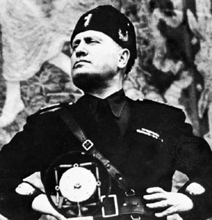
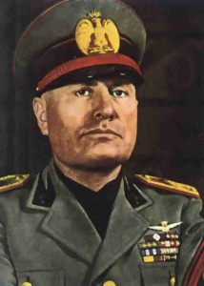
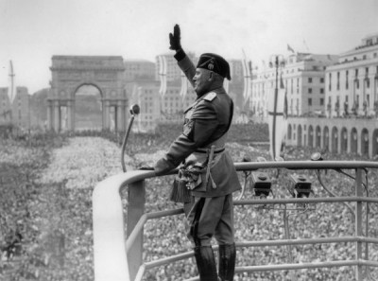
Mussolini

Slide 13
Benito Mussolini
Italy after WWI-high unemployment, rising inflation, and fear of a communists revolution
Mussolini promised to rescue Italy by rebuilding the armed forces
October of 1922-Fascists marched on Rome and demanded King Victor Emmanuel III put Mussolini in charge of the government
Called Il Duce- The Leader

Slide 14
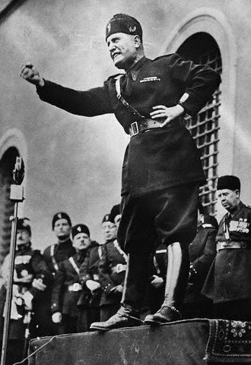
Il Duce—The Leader

